Slide 1
SQL Programming
Indexes

Slide 2
Module 06: Indexes Page A-1: Intro
In this module we consider yet another ‘common’ database object – the index.
Indexes don’t appear to be part of the SQL:1999 standard, rather they are provided as vendor extensions to the standard. But every programmer is terribly concerned about the performance of her programs, and indexes are one of the most common techniques/tools used to improve database performance.

Slide 3
Module 06: Indexes Page B-1: Index
The purpose of an index is to facilitate the retrieval of information.
About 100 years ago, when I was learning how to write COBOL programs, the instructor used an example of a dictionary to illustrate the concept of indexes. You see, back in the day, dictionaries had finger grooves/indexes for each letter of the alphabet. If you were looking for a word whose spelling started with the letter ‘J’, you would place your finger in the J groove, and flip the dictionary open to that spot, and start your word search from that point on.
These index grooves gave the user a ‘jump start’ on finding the word in the dictionary.
In those days, most students had a shared experience of having used a dictionary at some point in their lives. But as I think about that example today, I wonder how many of y’all have ever used a printed/bound dictionary?

Slide 4
Module 06: Indexes Page B-2: Index vs Primary Key
How does an index differ from a primary key?

Slide 5
Module 06: Indexes Page B-3: Index vs Primary key
How does an index differ from a primary key?
A primary key is sometimes referred to as a ‘unique identifier’, and serves to distinguish one record from another.
An index facilitates the locating and retrieval of a record by specifying where it physically is situated.
-----------------
Whereas a primary key identifies a record, an index helps to locate a record.

Slide 6
Module 06: Indexes Page C-1: Example of an Index
Let’s work thru an example.
Let’s suppose that we have yet another movie database, and in this scenario we have a single table with 10,000 rows, each record/row is 1,000 characters big.
Our task is to display some information about the record whose primary key value is 1003. The good news is that since we’re looking for a primary key value, there can be 1, and only 1, record in the database that satisfies our query.
So now, how does the database process this request?

Slide 7
Module 06: Indexes Page C-2: Example of an Index
Let’s work thru an example.
Let’s suppose that we have yet another movie database, and in this scenario we have a single table with 10,000 rows, each record/row is 1,000 characters big.
Our task is to display some information about the record whose primary key value is 1003. The good news is that since we’re looking for a primary key value, that there can be 1 and only 1 record in the database that satisfies our query.
So now, how does the database process this request?
To find this unique record, each row in the table must be read and examined until the DB finds the appropriate record. On average, these kinds of searches require the DB to examine half the records. With a table containing 10,000 rows, each search will, on average, read and process 5,000 rows.

Slide 8
Module 06: Indexes Page C-3: Example of an Index
Why 5,000?
You have to remember that there is no inherent ordering of records in the database. The rows aren’t sorted or alphabetized. They’re all just sitting in that table in a giant heap. And to locate any record in that heap, you start at the top and work your way to the bottom.
And generally, on average, you process half the records in a heap before you find the single one you’re looking for.
So how does an index help?

Slide 9
Module 06: Indexes Page C-4: Example of an Index
Why 5,000?
You have to remember that there is no inherent ordering of records in the database. The rows aren’t sorted or alphabetized. They’re just all in that table in a giant heap. And to locate any record in that heap, you start at the top and work your way to the bottom.
And generally, on average, you process half the records in a heap before you find the single one you’re looking for.
So how does an index help?
First off, think of an index as an ordered list. Every entry on that list is arranged in order.
Once we impose some order on the list, then we can use various searching strategies to optimize the time it takes to locate a record.
 | Key Value | Location
1 | 1003 | Slot 1
2 | 1008 | Slot 3
3 | 1009 | Slot 2
4 | 1014 | Slot 4
5 | 1015 | Slot 1
6 | 1016 | Slot 3
7 | 1020 | Slot 2
8 | 1031 | Slot 4
9 | 1042 | Slot 1
10 | 1043 | Slot 3
11 | 1050 | Slot 2

Slide 10
Module 06: Indexes Page C-5: Example of an Index
Perhaps the simplest searching strategy is the binary search. It works by ‘halving’ the search space until it finds the value it’s looking for, or recognizes the value isn’t there.
← Here is my index.
It contains two values for each record. One value is the primary key value, the other is the physical location in the database where the record with that value resides.
Let’s say I’m looking for the record whose primary key is 1042.
Cut the index space in half. (We’re looking at the 6th element in the list) Is 1042 in the top half or bottom half? Top half.
Cut the remaining space in half. (We’re looking at 8th element in the list) Is 1042 in the top half or bottom half? Top half.
Cut the remaining space in half, …
 | Key Value | Location
1 | 1003 | Slot 1
2 | 1008 | Slot 3
3 | 1009 | Slot 2
4 | 1014 | Slot 4
5 | 1015 | Slot 1
6 | 1016 | Slot 3
7 | 1020 | Slot 2
8 | 1031 | Slot 4
9 | 1042 | Slot 1
10 | 1043 | Slot 3
11 | 1050 | Slot 2

Slide 11
Module 06: Indexes Page C-6: Example of an Index
With a binary search we can find any record in about Log₂N hits. Or something like that ;-)
If I’ve got 32 entries in my list, I can find any value in about 5 hits (ie, 2⁵=32)
If I’ve got 64 entries in my list, I can find any value in about 6 hits (ie. 2⁶=64)
For a table having 10,000 rows, I can find any entry in about 14 hits (2¹³ = 8,192 , 2¹⁴=16,384 ).
And I’m sure you can appreciate that 14 hits (or reads) is a whole lot better than 5,000 hits (or reads). And that’s the only point of this discussion.
Indexes improve the performance of a database by speeding up the time it takes to retrieve a record.
 | Key Value | Location
1 | 1003 | Slot 1
2 | 1008 | Slot 3
3 | 1009 | Slot 2
4 | 1014 | Slot 4
5 | 1015 | Slot 1
6 | 1016 | Slot 3
7 | 1020 | Slot 2
8 | 1031 | Slot 4
9 | 1042 | Slot 1
10 | 1043 | Slot 3
11 | 1050 | Slot 2

Slide 12
Module 06: Indexes Page C-7: Downside of Indexes
Indexes sound perfect, don’t they?
So what’s the downside?
Is there a cost?
You bet. The index must be maintained, and although most databases perform that maintenance for you, there’s overhead involved.
There’s the overheard in creating new entries in an index for new values as they’re added to the table, there’s overhead in deleting index entries when rows are removed from the table, and there’s overhead involved when values are changed in the database, and the index must be updated accordingly.
 | Key Value | Location
1 | 1003 | Slot 1
2 | 1008 | Slot 3
3 | 1009 | Slot 2
4 | 1014 | Slot 4
5 | 1015 | Slot 1
6 | 1016 | Slot 3
7 | 1020 | Slot 2
8 | 1031 | Slot 4
9 | 1042 | Slot 1
10 | 1043 | Slot 3
11 | 1050 | Slot 2

Slide 13
Module 06: Indexes Page C-8: Index
That’s it for the theory behind indexes.
And yes, there’s a lot more about indexes that you can investigate and study, but those endeavors are beyond the scope of this class.
Let’s build a couple of indexes so you can see the mechanics involved.
 | Key Value | Location
1 | 1003 | Slot 1
2 | 1008 | Slot 3
3 | 1009 | Slot 2
4 | 1014 | Slot 4
5 | 1015 | Slot 1
6 | 1016 | Slot 3
7 | 1020 | Slot 2
8 | 1031 | Slot 4
9 | 1042 | Slot 1
10 | 1043 | Slot 3
11 | 1050 | Slot 2

Slide 14
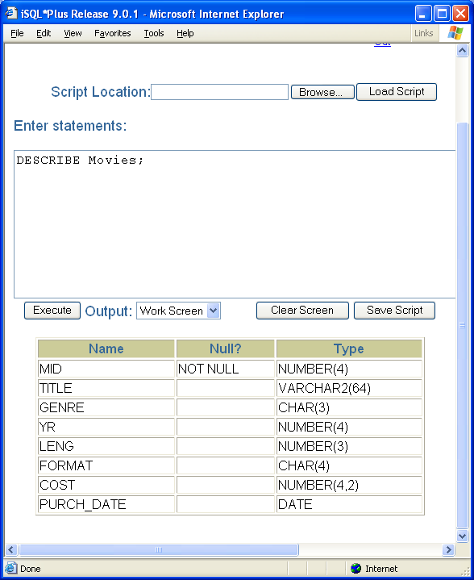
Module 06: Indexes Page D-1: Indexes
Indexes are schema objects.
Objects in the database are created with the CREATE command.
The general form of the CREATE command is:
CREATE object_type object_name
For indexes that would be:
CREATE INDEX index_name;

Slide 15
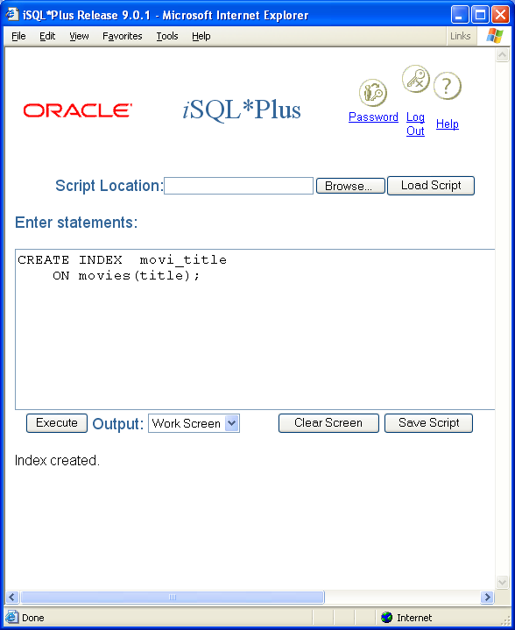
Module 06: Indexes Page D-2: CREATE INDEX
We can create an index on the title column of the movies table by issuing the following command:
CREATE INDEX movi_title
ON movies(title);

Slide 16
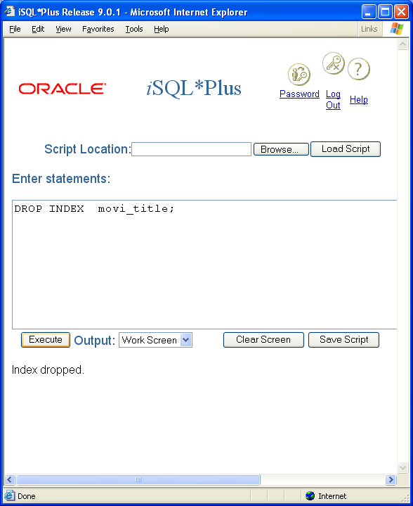
Module 06: Indexes Page D-3: Dropping Indexes
An index can be removed by using the DROP command.
For example:
DROP INDEX movi_title;

Slide 17
Module 06: Indexes Page D-3: Implicit / Explicit
In Oracle database systems, an index is implicitly created for you whenever you define a primary key, or unique constraint.
All other indexes in the database must be explicitly created manually by the programmer via the CREATE INDEX command.
Implicitly created indexes are named as the constraint was named.

Slide 18
Module 06: Indexes Page D-4: Implicit / Explicit
The syntax for index creation in MySQL is as follows:
CREATE [UNIQUE|FULLTEXT|SPATIAL] INDEX index_name [index_type]
ON tbl_name (index_col_name,...)
index_col_name:
col_name [(length)] [ASC | DESC]
Note here that the column name for the index can be specified along with a length value. This permits the programmer to build an index on something smaller than the full length of the column. In some environments, for some applications, this might be more efficient than defining an index on the entire length of the column.

Slide 19
Module 06: Indexes Page E-1: More Miscellany
Indexes can be built on multiple columns.
(This should be ‘intuitive’ if you recall that a primary key can be defined on a collection of columns – ie a composite key)
There are different index types that may be available in your database system. Each index type is optimized for a particular usage, that depends on the nature of the data, whether duplicate values are allowed, the distribution of values, and the nature of inquiries and updates.

Slide 20
Module 06: Indexes Page E-2: General Use
Columns that contain a wide range of values are good candidates for indexes.
Indexes are also useful when the table is large and the typical inquiry (SELECT) retrieves only a small portion of the table (< 10%)
Indexes are not very useful when the table is small, or on columns that are frequently updated.

Slide 21
Module 06: Indexes Page T-1: Terminology
Index
Heap
Binary search
Implicitly created
Explicitly created

Slide 22
Module 06: Indexes Page Z-1: End Notes
Please drop me an email if you noticed any errors in this module. I’d also appreciate reading your comments, criticisms, and or suggestions as to how this module could be improved.
Were there any gaps in the information that was presented (ie. ‘leaps of faith’)?
Was any section unclear?
Did I happen to do a good job? ☺
Thanks,
bil

Slide 23
That’s All

